Slide 1
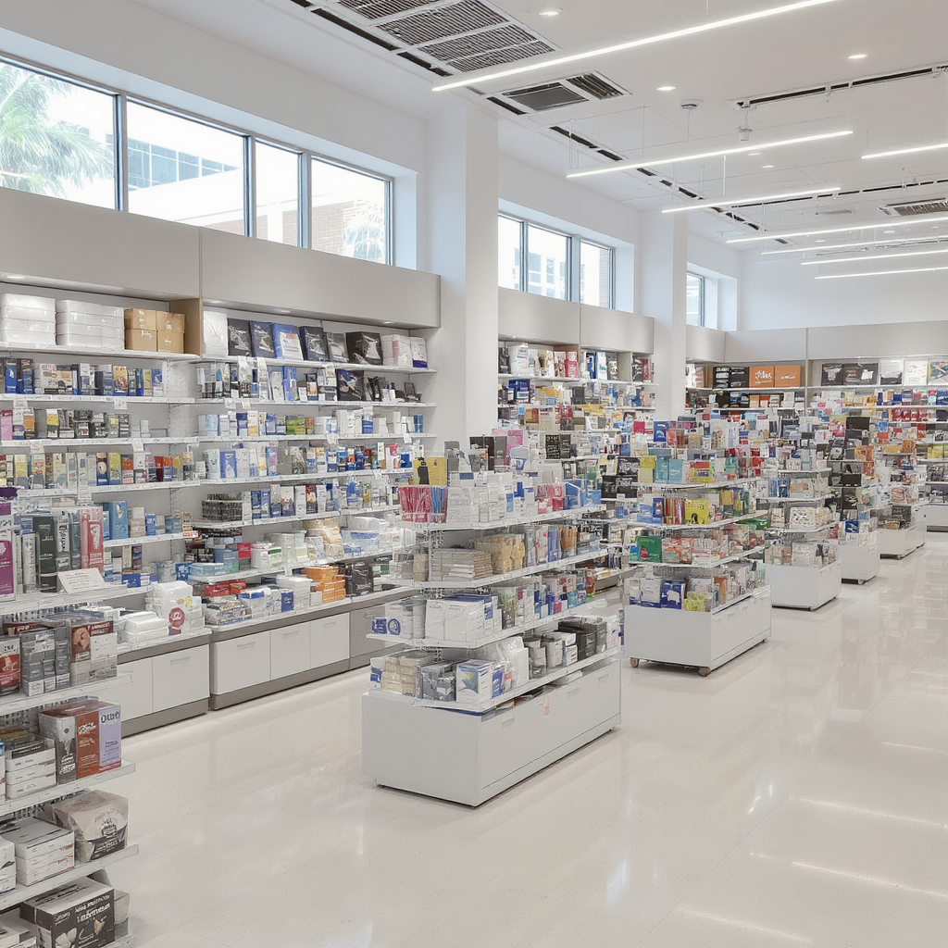
Office Supply Store Trends in 2020
Foot Traffic and Dwell Time Trends at Office Supply Stores During the Remote Work Shift
October 12, 2025

Slide 2
Key Research Questions and Analysis Approach
Research
01
Research Questions
How did foot traffic and dwell times evolve week by week during the first four months of 2020? Which demographic factors like education, working-age, and K-12 households influence visits? Which brands recovered fastest and what does this indicate about loyalty and essential purchasing?
02
Geographic & Industry Focus
Focused on Office Supply Stores in California counties classified as Urban, Suburban, and Rural using 2020 RUCA Codes. Analysis covers local-level trends at county and brand-location scales.
03
Data & Methodology Summary
Used SafeGraph datasets for visits and dwell time, joined with Census Block Group demographics. Weekly visits and median dwell times were aggregated from daily data using SQL queries for detailed temporal and spatial analysis.

Slide 3
Foot Traffic and Dwell Time Trends
Analysis
01
Visit Trends
All brands peaked in Jan-Feb 2020, then dropped sharply starting Week 12 (March 16–22) due to lockdowns. Staples and Office Depot led visits, each with 100K+ weekly visits pre-March. Staples rebounded in Week 17 with nearly 98K visits, driven by home-office supply needs.
02
Dwell Time Patterns
Staples and Office Depot have shorter dwell times, reflecting quick, frequent trips. Specialty stores like Papyrus and Rapid Refill attract fewer visitors but longer dwell times, showing focused, high-intent purchases. Rapid Refill’s dwell time is about 50 minutes.
03
K-12 Population Link
Office retailers cluster near suburban, family-focused areas, driven by school and home office demand. Staples serves 2.4M K-12 population with 1.76M visits. Office Depot shows similar trends. Papyrus serves smaller K-12 populations with fewer visits.
04
Working-Age Population Link
Counties with higher working-age density (urban/suburban) show shorter dwell times, indicating faster shopping. Staples serves 10.65M working-age people with 16.8 min dwell time. Cartridge World and Papyrus have smaller workforces but longer dwell times (31.1 and 39.7 min).
05
Education & Engagement
Longer dwell times occur in areas with more bachelor’s and master’s degree holders, linked to higher income and preference for personalized shopping. Staples serves mixed education with 16.8 min dwell. Paper Source and Papyrus have longer dwell times (29.9 and 39.7 min) in highly educated areas.

Slide 4
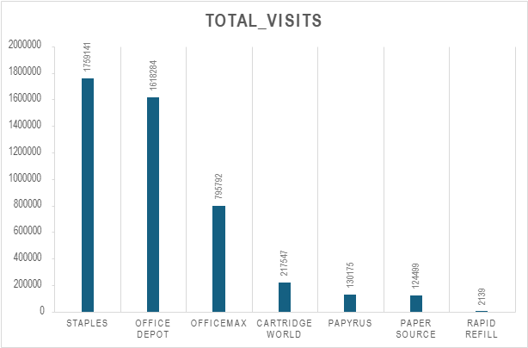
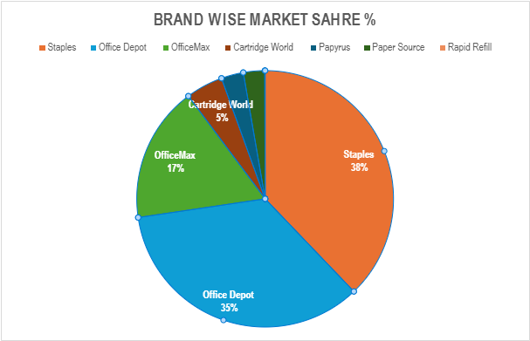
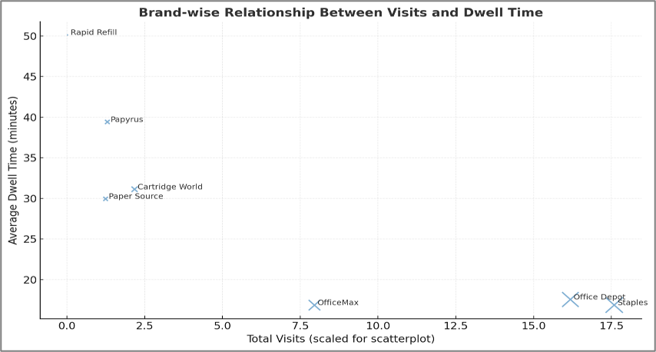
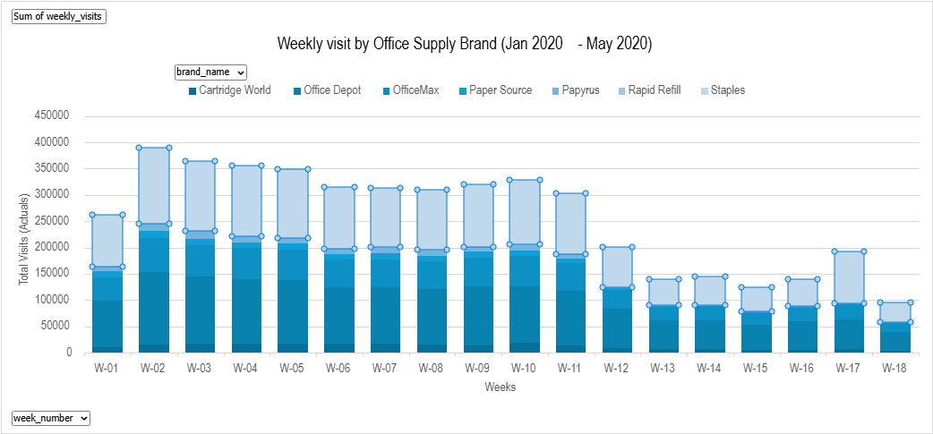
Office Supply Store Visits Overview (Jan 2020 - APR 2020)
Market Trends

Slide 5
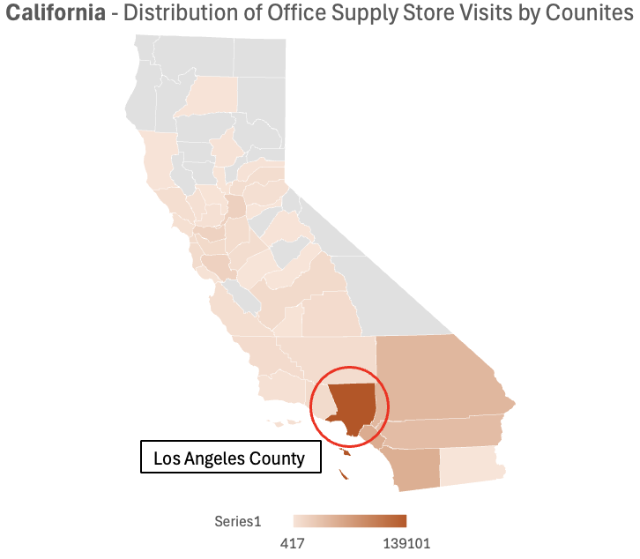
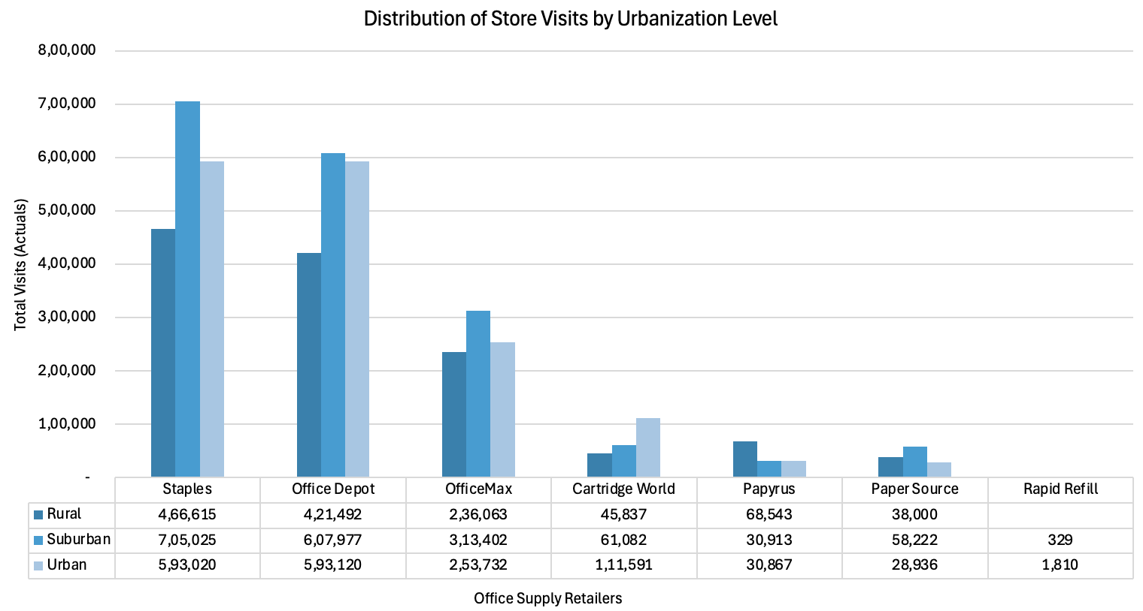
Suburban vs Urban Store Visits & Engagement
Regional Trends
Suburban vs Urban Visit Trends
Specialty Brand Engagement and Geographic Hotspots
Suburban counties showed the highest visits and engagement, led by Staples and Office Depot. These areas experienced faster recovery after the remote work shift starting March 2020. Urban areas had slightly lower visits but similar dwell times, indicating quicker, goal-oriented trips. Rural areas recorded fewer visits but longer dwell times, reflecting more deliberate shopping.
Specialty brands like Papyrus and Rapid Refill recorded lower traffic but higher dwell times. These longer visits suggest more purposeful, high-value purchases in niche markets. Los Angeles County, CA, emerged as a key hotspot for office supply demand during early 2020. The distinct patterns reflect different consumer priorities: convenience in suburbs and experience in specialized stores.

Slide 6
Brand Recovery and Consumer Behavior Insights
Recovery
Staples and Office Depot stabilized visits around Weeks 16–17, with Staples rebounding rapidly from 47K to nearly 98K weekly visits by Week 17, highlighting its essential status and strong brand loyalty. Office Depot showed a gradual recovery with steady visits between Weeks 17–18, reflecting reliability and convenience as essential retailers. OfficeMax experienced a slower and more moderate rebound around Week 18, possibly due to brand overlap with Office Depot diluting traffic. Specialty brands like Paper Source and Papyrus showed no clear stabilization; visits remained low or declined post-March, reflecting reduced in-store browsing and discretionary purchase declines. Rapid Refill maintained minimal activity with stable but very low volume, indicating a niche audience with deep but narrow engagement and limited recovery potential.
Brand | Stabilization Week | Recovery Pattern | Key Interpretation
Staples | WK 16–17 | Rapid rebound after steep mid-March dip | Strong brand loyalty and essential status drove early recovery; demand tied to home-office setup.
Office Depot | WK 17–18 | Gradual recovery and steady visits | Maintained consistent customer base; reflects reliability and convenience as essential retailer.
OfficeMax | WK 18 | Slower, moderate rebound | Some brand overlap with Office Depot may have diluted traffic; secondary player in essential category.
Cartridge World | WK 17 | Partial stabilization | Specialized product line led to moderate rebound; supported by printer and cartridge needs for remote work.
Paper Source | No clear stabilization | Visits remained low through April | Non-essential, creative products saw sustained decline; recovery delayed by reduced in-store browsing.
Papyrus | No clear stabilization | Continued decline post-March | Discretionary gifting and stationery purchases collapsed; slow adaptation to online demand.
Rapid Refill | Minimal activity | Stable at very low volume | Niche audience with deep but narrow engagement; limited market reach and low recovery potential.

Slide 7
Thank you

